Slide 1
Lecture 05 Machine Language II COMP1411: Introduction to Computer Systems
Dr. Mingsong LYU (呂鳴松)
Department of Computing,
The Hong Kong Polytechnic University
Spring 2023
Acknowledgement: These slides are based on the textbook (Computer Systems: A Programmer’s Perspective) and its slides.
These slides are only intended to use internally. Do not publish it anywhere without permission.

Slide 2
Outline
Basic definitions on machine code
Registers and operands
Moving data between memory and CPU
Arithmetic and logical operations
Control
Conditional branches
Loops

Slide 3
An example of control in a C program
A program not only performs
z = x + y;
a = b & c;
......
It also performs different actions according to some condition
x = 5;
y = 7;
if (x > y){ // the program needs to know T/F
x = x + y;
}
else{
y = x + y;
}

Slide 4
General purpose registers
General purpose registers used for data movement and arithmetic/logical computation
%rax
%r8
%rbx
%r9
%rcx
%r10
%rdx
%r11
%rsi
%r12
%rdi
%r13
%rsp
%r14
%rbp
%r15

Slide 5
Condition codes
Condition codes: single bit registers
Special single-bit registers to record the states of computation
Not visible to programmers, implicitly set by different types of instructions
Read by special instructions
CF
Carry Flag (for unsigned)
ZF
Zero Flag
SF
Sign Flag
OF
Overflow Flag (for signed)

Slide 6
Set by arithmetic operations
addq Src,Dest ↔ t = a + b
CF set if carry out from the most significant bit (unsigned overflow)
ZF set if t is zero
SF set a copy of the highest bit of the dest, if t < 0 (signed)
OF set if two’s-complement (signed) overflow (a>0 && b>0 && t<0) || (a<0 && b<0 && t>=0)
Automatically and implicitly set: as a side effect of arithmetic operations
CF
ZF
SF
OF

Slide 8
Set by compare instructions
cmp* Src, Dest
* = q, l, w, b
cmpl b,a like computing a-b but do not change the value of a, the value of dest is not changed
CF set if carry out from most significant bit (used for unsigned comparisons)
ZF set if a == b
SF set if (a-b) < 0 (signed)
OF set if two’s-complement (signed) overflow
a>0 && b<0 && (a-b)<0) || (a<0 && b>0 && (a-b)>0)
CF
ZF
SF
OF

Slide 9
Set by test instructions
test* Src, Dest
* = q,l,w,b
testl b,a like computing a&b without changing a
Sets condition codes based on value of Src & Dest
ZF set when a&b == 0
SF set when the highest bit of a&b is 1
CF
ZF
SF
OF

Slide 10
Reading condition codes
SetX Instructions
setX %register
Read one condition code or a combination of multiple condition codes
and set the corresponding value to a single-byte register
SetX | Condition | Description
sete | ZF | Equal / Zero
setne | ~ZF | Not Equal / Not Zero
sets | SF | Negative
setns | ~SF | Nonnegative
setg | ~(SF^OF)&~ZF | Greater (Signed)
setge | ~(SF^OF) | Greater or Equal (Signed)
setl | (SF^OF) | Less (Signed)
setle | (SF^OF)|ZF | Less or Equal (Signed)
seta | ~CF&~ZF | Above (unsigned)
setb | CF | Below (unsigned)

Slide 11
Reading condition codes
Understanding setg: ~(SF^OF)&~ZF
cmpl y, x (like computing x – y)
setg %al (put the evaluation result to the register %al)
Assume x and y are signed integers
Case 1: no overflow
Case 1.1: x == y, ZF = 1, ~ZF = 0 ➔ %al = 0
Case 1.2: x < y, ZF = 0, ~ZF = 1; SF = 1, OF = 0, ~(SF^OF) = 0 ➔ %al = 0
Case 1.3: x > y, ZF = 0, ~ZF = 1; SF = 0, OF = 0, ~(SF^OF) = 1 ➔ %al = 1
Case 2: overflow
Case 2.1: x < 0, y > 0, negative overflow, SF = 0, OF = 1, ZF = 0 ➔ %al = 0
Case 2.2: x > 0, y < 0, positive overflow, SF = 1, OF = 1, ZF = 0 ➔ %al = 1

Slide 12
Reading condition codes
TAdd overflow visualized
True Sum
0 111…1
2^{w}–1
4-bit integer (-8 to 7)
x = -6 = 1010₂
y = 4 = 0100₂
x -y = -10 (overflow)
1 0 1 0
- 0 1 0 0
------------------
0 1 1 0 → 6
PosOver
TAdd Result
0 100…0
2^{w –1}–1
011…1
0 000…0
0
000…0
1 011…1
–2^{w –1}
100…0
1 000…0
–2^{w}
NegOver

Slide 13
Outline
Basic definitions on machine code
Registers and operands
Moving data between memory and CPU
Arithmetic and logical operations
Control
Conditional branches
Loops

Slide 14
Jump instructions – change the control flow
By default, a CPU executes the instructions sequentially
jX instructions
Change the instruction sequence by jumping to a target address either specified by absolution address or by a value in some register or memory
jX | Condition | Description | cmp a, b
jmp | 1 | Unconditional | ---
je | ZF | Equal / Zero | b == a
jne | ~ZF | Not Equal / Not Zero | b != a
js | SF | Negative | b < a
jns | ~SF | Nonnegative | b >= a
jg | ~(SF^OF)&~ZF | Greater (Signed) | b > a
jge | ~(SF^OF) | Greater or Equal (Signed) | b >= a
jl | (SF^OF) | Less (Signed) | b < a
jle | (SF^OF)|ZF | Less or Equal (Signed) | b <= a
ja | ~CF&~ZF | Above (unsigned) | b > a
jb | CF | Below (unsigned) | b < a

Slide 15
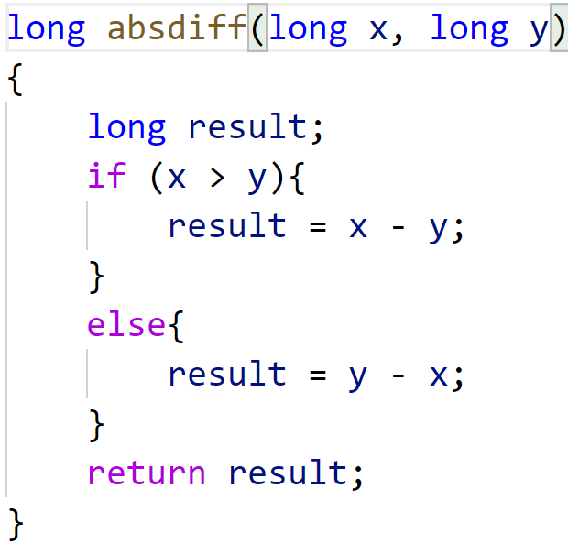
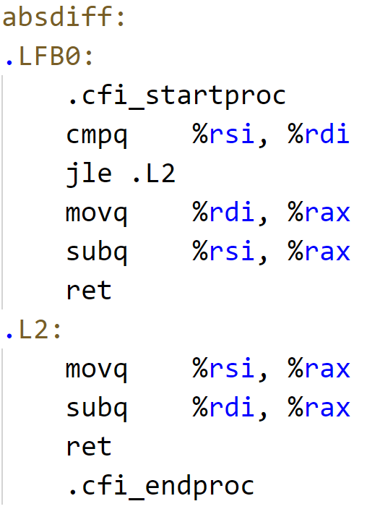
Implementing conditional branches with jX
gcc –m64 –Og –S control.c
Variable | Register
x | %rdi
y | %rsi
result | %rax
movq %rdi, %rax
result = x
subq %rsi, %rax
result = result – y
cmpq %rsi, %rdi
compute %rdi - %rsi (x-y) and set control flags
jle .L2
(SF ^ OF) | ZF
If (x – y <= 0), either SF^OF is evaluated 1 or ZF is set to 1, the condition for jle is evaluated TRUE, the jump to .L2 will be taken
movq %rsi, %rax
result = y
subq %rdi, %rax
result = result – x

Slide 16
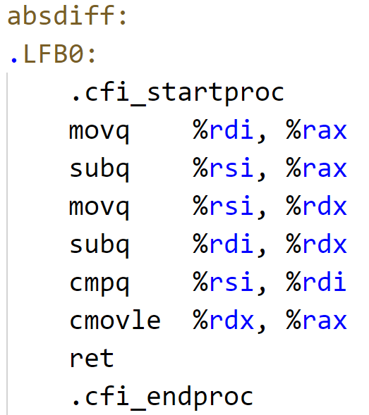
Conditional branches by conditional moves
“conditional move”: move when the given condition is met
gcc –m64 –Og –S –fif-conversion control.c
Variable | Register
x | %rdi
y | %rsi
result | %rax
Execute both branches
%rax : x – y
%rdx : y – x
Do the test later
cmpq %rsi, %rdi
compute %rdi - %rsi (x-y) and set control flags
cmovle
(SF ^ OF) | ZF
If (x – y <= 0), either SF^OF is evaluated 1 or ZF is set to 1, the condition for jle is evaluated TRUE, the jump to .L2 will be taken
cmovle
if (x <= y)
%rdx → %rax
%rax = y – x
return %rax

Slide 17
Conditional branches by conditional moves
Why using conditional moves?
Sometimes, executing both branches will be faster then “test and jump”
Because, modern processors use pipelines to execute a sequence of instructions, and branching operation may cause the pipeline to stall
Let’s revisit the problem in LEC06

Slide 18
Conditional branches by conditional moves
Conditional moves should not be used in some cases
CASE 1: Expensive computation
Both values get computed with complex logic that takes a long time
Executing both branches will be not worthwhile
CASE 2: risky computation
This statement is to avoid referencing an address with value 0
By conditional moves, the address is referenced anyway
CASE 3: computation with side effects
Both values get computed
Must ensure it is side-effect free
Fortunately, the compiler will do the decision
val = Test(x) ? Hard1(x) : Hard2(x);
val = p ? *p : 0;
val = x> 0 ? x*=7 : x+=3;

Slide 19
Rethinking Case 1 and 3 of the previous page
Our student Kent gives a compilation result showing that it is POSSIBLE to use conditional move for case 1 and 3, which changes the conclusions of the two cases in the previous page
Take case 3 for example
val = x> 0 ? x*=7 : x+=3;
Assuming the compiler allocate x to register %rdi, then we can have the following compiled assembly code using cmov
The point is, if we save the original value of x to some register, there is in fact a chance to execute the two branches before performing the testing
movq %rdi, %rax
mulq $7, %rax
movq %rdi, %rdx
addq $3, %rdx
cmpq $0, %rdi
cmovle %rdx, %rax
ret

Slide 20
Outline
Basic definitions on machine code
Registers and operands
Moving data between memory and CPU
Arithmetic and logical operations
Control
Conditional branches
Loops

Slide 21
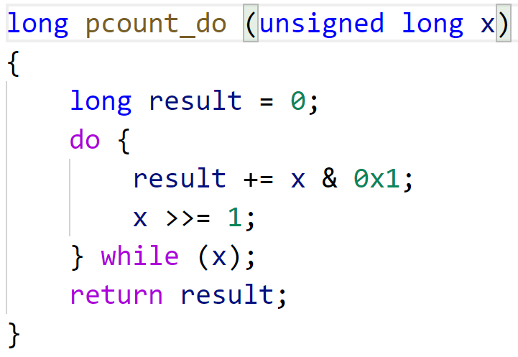
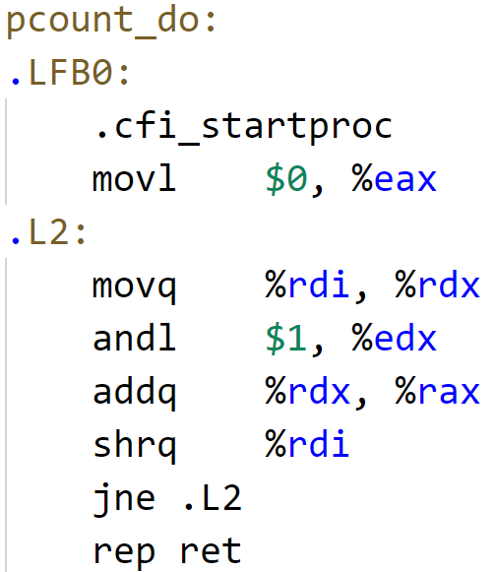
“do-while” loop
An example to count the number of 1’s in “x”
result = 0
temp = x & 0x1
result += temp
x >>= 1
if after x >>= 1, x == 0, the ZF flag will be set to 1, and jne will be evaluated FALSE, the program will not loop back
Variable | Register
x | %rdi
result | %rax

Slide 22
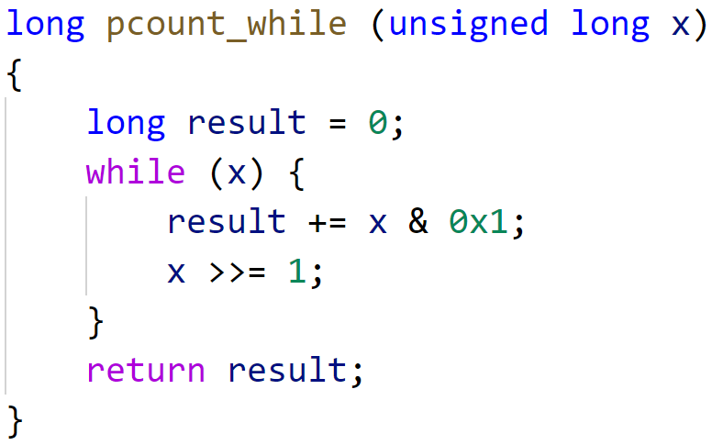
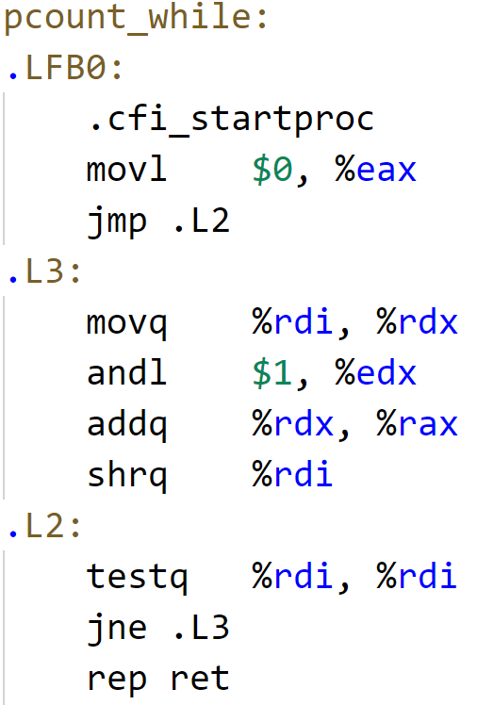
“while” loop
result = 0
while(x)
if after x >>= 1, x == 0, the ZF flag will be set to 1, and jne will be evaluated FALSE, the program will not loop back
Variable | Register
x | %rdi
result | %eax

Slide 23
“for” loop
“for” loop can be transformed into “do-while”loop or “while” loop
for (init; test; update)
Body;
init;
goto L_TEST;
L_LOOP:
Body;
update;
L_TEST:
if (test)
goto L_LOOP;
L_DONE:
// while loop
init;
if (test){
Body;
update;
}

Slide 24
Summary of machine language I & II
The abstract computer that assembly code works on
General purpose registers + condition codes
Arithmetic and logical operations
Program flow control
Conditional codes
Branches
Loops
Other topics uncovered due to limited course time
Function calls
Complex data structures

Slide 25
Thank You

